Slide 1
Deep Neural Networks And Where to Find Them
Lecture 5
Artem Korenev, Nikita Gryaznov

Slide 2
Recap of Convolutional NNs

Slide 3
Recap – Convolutional Neural Network
Learning small filters (kernels) to catch useful features
Using convolution operation to apply filter to every position on the feature map (or on the image)
Adding layers of convolutions – filters learn more complex features
Result of the convolution
Kernel
(i.e. filter)
has size 3x3
Initial Image

Slide 4

Recap – Kernels Learn Useful Features
Initial Image
Feature Map
Applying Kernel that responds to cat face pattern
Kernel fired to the pattern and left big values on the feature map

Slide 5
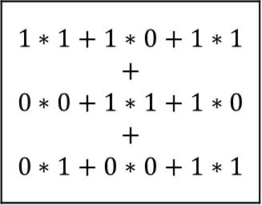

Recap – Convolution Computations
$$1∗1+1∗0+1∗1$$ $$+$$ $$0∗0+1∗1+1∗0$$ $$+$$ $$0∗1+0∗0+1∗1$$
$$=4$$
Kernel
(i.e. filter)
has size 3x3
Kernel Values
1 | 0 | 1
0 | 1 | 0
1 | 0 | 1

Slide 6
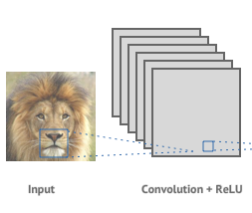
Recap – Number of Channels
We applied 6 different kernels, therefore we obtain 6 feature maps
Now we can treat these 6 feature maps as a new image with 6 channels to pass it further so we can apply new HxWx6 kernels on the next layer
3 color channels for this image (RGB)
Let’s assume that this window has size of 20x20 pixels
Therefore we apply kernels of size 20x20x3 to the image

Slide 7
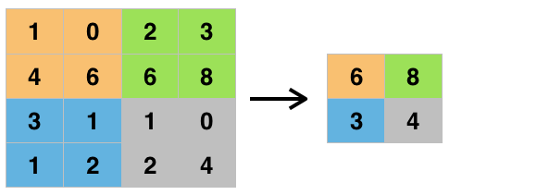
Recap – Max Pooling
Max Pooling window size is set to 2x2

Slide 8
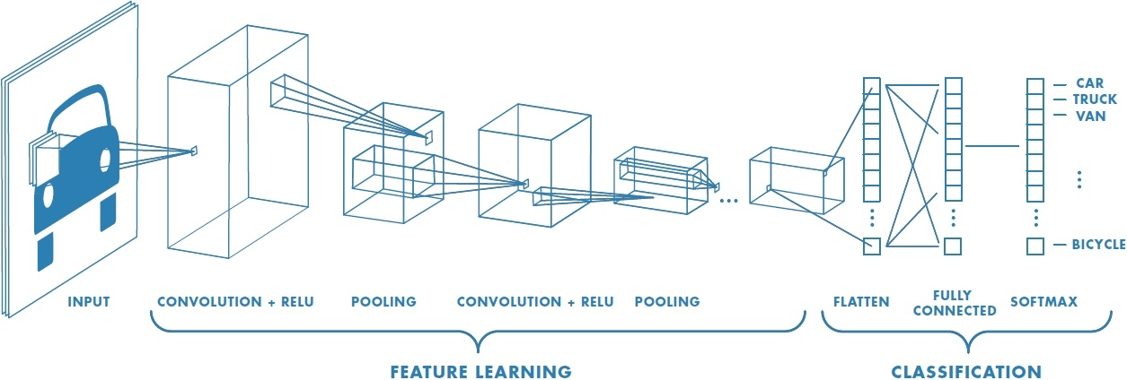
Recap – Basic Structure of CNN
Flattening the feature map – making one shallow vector out of the ‘image’

Slide 9
Deep Convolutional NNs

Slide 10
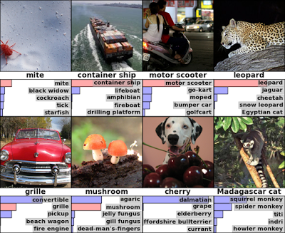
ImageNet Classification Challenge
1000 classes
1.2kk training images, 150k
Main metric: top-5 error

Slide 11
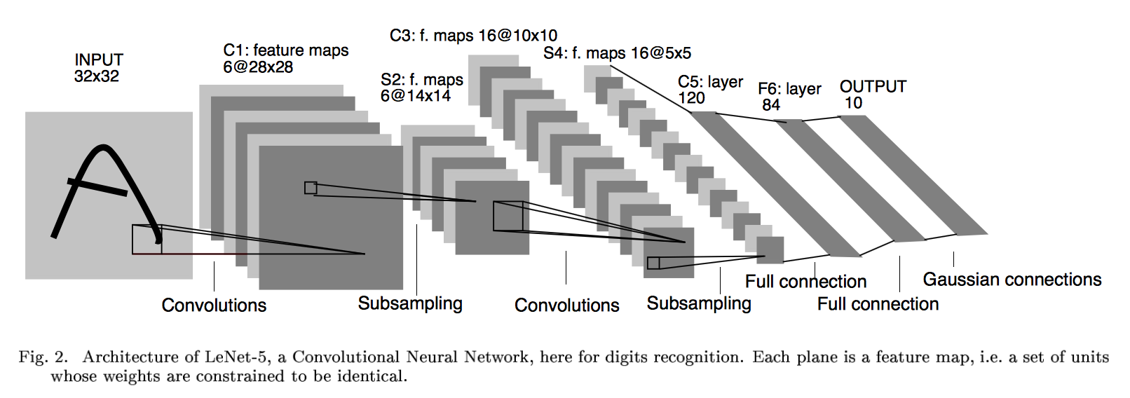
LeNet
Created by Yann LeCun in 1998 (!)
Classification of handwritten digits dataset (MNIST)

Slide 12
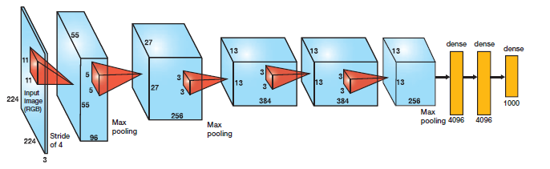
AlexNet - ImageNet 2012 Winner
First winning deep learning solution
Convolutions 11x11, 5x5 and 3x3
3 Dense layers at the end
Top-1 Acc: 57%, Top-5 Acc: 80.3%

Slide 13
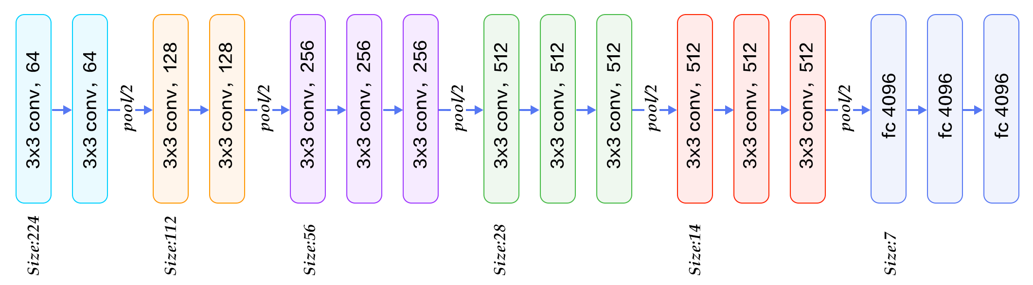
VGG – 2014
Improved AlexNet
There are two versions: VGG16 and VGG19 (number of layers)
Transforming big convolutions to a subsequent 3x3 Convolutions
E.g. 7x7 -> 3*(3x3)
VGG19 Top-5 Acc: 92.7%
Dense Layers

Slide 14
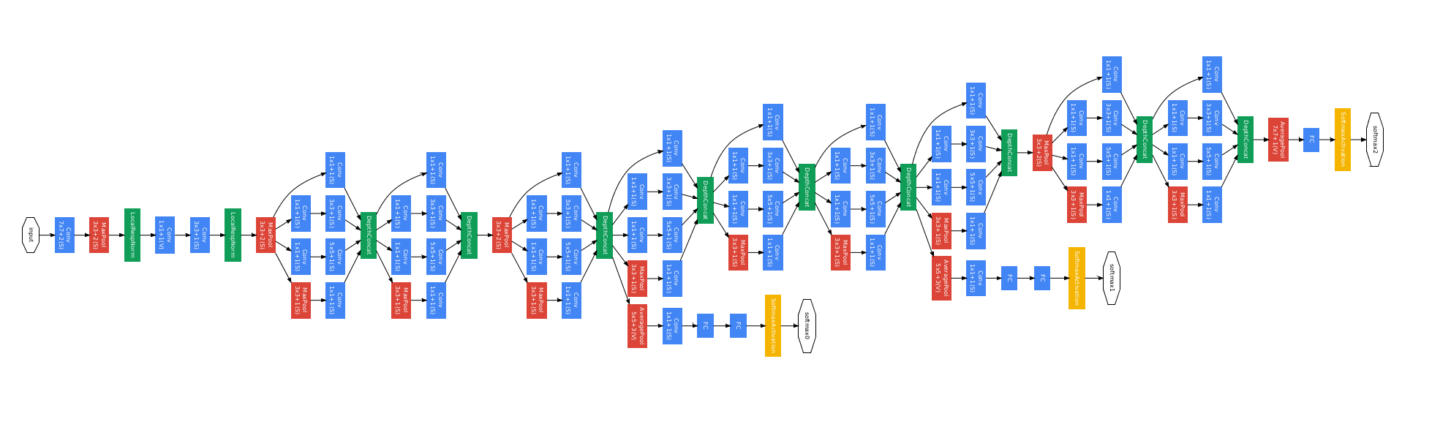
GoogleNet – ImageNet 2014 Winner
Making NN more tree-structured
Created Inception Model
Top-5 Acc: 93.3%

Slide 15
GoogleNet – ImageNet 2014 Winner
Making NN more tree-structured
Created Inception Model
Top-5 Acc: 93.3%
Inception Module

Slide 16
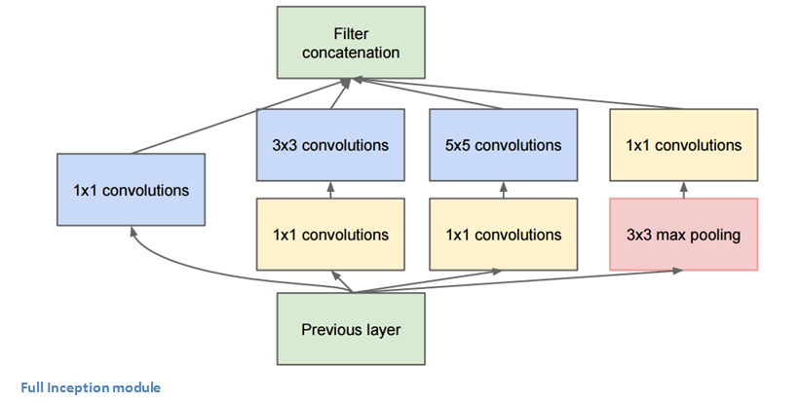
GoogleNet – Inception Module
Stack channels of all inputs together
Reducing number of channels to reduce number of computations

Slide 17
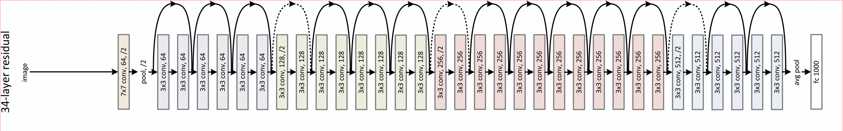
ResNet – ImageNet 2015 Winner
Released by Microsoft
They won every other competition as well
ResNet-50, ResNet-101, ResNet-152
Using idea of residual connections
Top-5 Acc: 96.43% (surpasses human performance)
Number of layers!

Slide 18
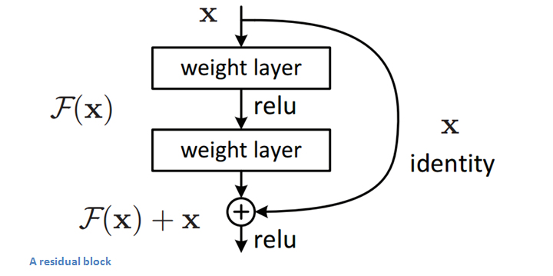
ResNet – Residual Block

Slide 19
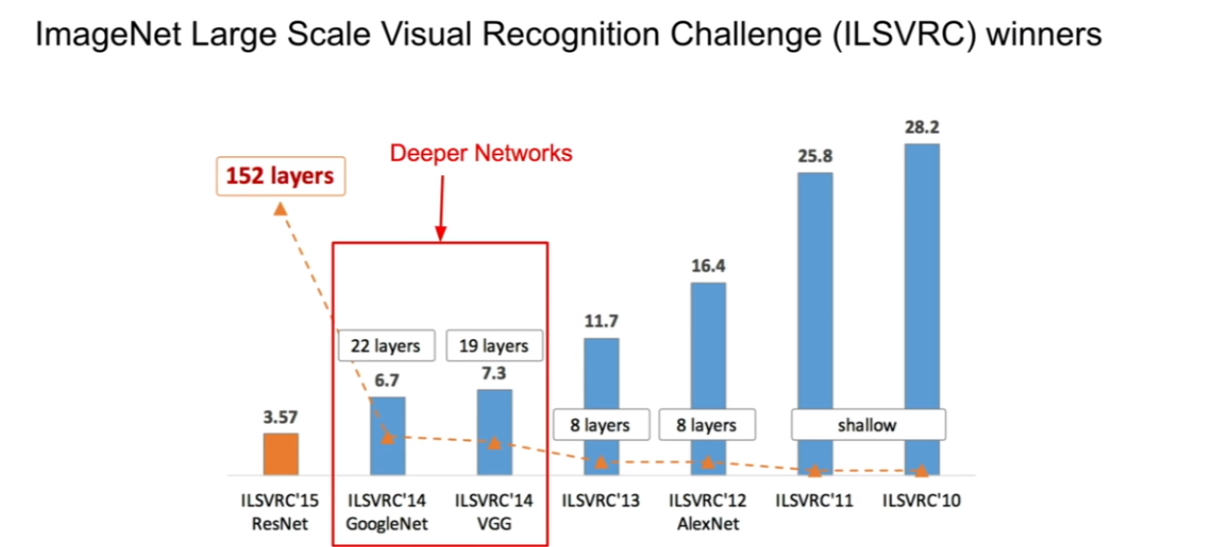
Layers and Performance

Slide 20
Transfer Learning
We can reuse these high-performance NNs
Pretrained NNs are available
You can create the same NN but with different final layers to adjust it to your problem
Then you learn the whole network or only small parts of it to train it directly on your model
These models exists mostly for image classification only

Slide 21
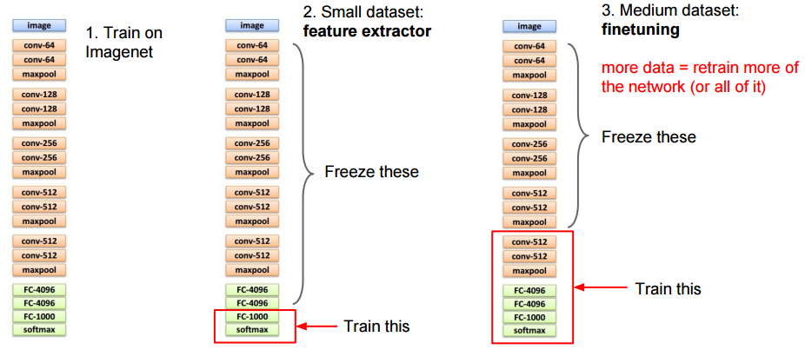
Transfer Learning

Slide 22
What is Used Nowadays
ResNet, Inception, VGG networks are still used
ResNet is the most popular choice
Choose ResNet version for your problem (trade-off for complexity, time, amount of parameters, memory consumption…)
Never train them from scratch – train it from pretrained version

Slide 23
Final Recap

Slide 24
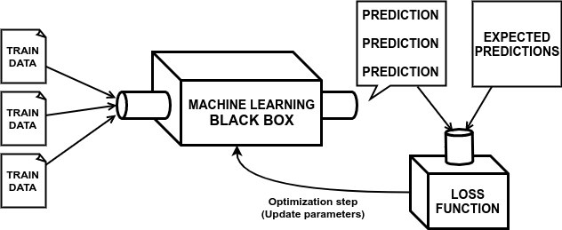
Machine Learning Algorithms

Slide 25
Machine Learning Algorithms
Our Model

Slide 26
Machine Learning Algorithms
Model Output
Our Model

Slide 27
Machine Learning Algorithms
Model Output
Our Model
Computing badness of the model

Slide 28
Machine Learning Algorithms
Model Output
Our Model
Changing the model slightly to make it better
Computing badness of the model

Slide 29
Neural Network as a ML Black Box
Neural Network

Slide 30
Types of Problems and Losses
Most frequent problems:
Classification (predicting label(s) across the predefined set)
Losses:
Binary Cross Entropy (2 classes) or Categorical Cross Entropy (>2 classes)
(rarely) Hinge Loss
Regression (predicting real value without predefined set of outcomes)
Losses:
Mean Squared Error (L2 Loss)
Mean Absolute Error (L1 Loss)

Slide 31












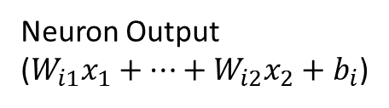
Dense Layer
Dense Layer
$x_{1}$
Layer input
$x_{1}$
$$W$$
Neuron Output
($W_{i1}x_{1}+…+W_{i2}x_{2}+b_{i}$)
$$f$$
$$x_{2}$$
Activation function
(Non-linearity)
(Neuron activation)
$$f$$
$$x_{3}$$
$$f$$
$$x_{4}$$
Layer weight
(trainable parameter)
$$f$$
$$b$$
$$1$$
Layer bias
(trainable parameter)

Slide 32





















Multi Layer Neural Network
Dense Layer
Dense Layer
Dense Layer
$x_{1}$
$$W_{1}$$
$$W_{2}$$
$$f$$
$$f$$
$$W_{3}$$
$$x_{2}$$
$$f$$
$$x_{3}$$
$$f$$
$$f$$
$$f$$
$$x_{4}$$
$$f$$
$$f$$
$$b_{1}$$
$$b_{2}$$
$$b_{3}$$
$$1$$
$$1$$
$$1$$

Slide 33







Regression Problem
Often no activation function is used!
Dense Layer
Dense Layer
Dense Layer
$x_{1}$
$$W_{1}$$
$$W_{2}$$
$$f$$
$$f$$
$$W_{3}$$
$$x_{2}$$
$$x_{3}$$
$$f$$
$$f$$
$$x_{4}$$
$$f$$
$$f$$
$$b_{1}$$
$$b_{2}$$
$$b_{3}$$
$$1$$
$$1$$
$$1$$

Slide 34
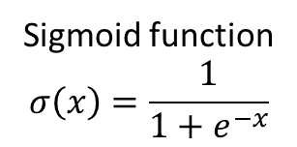








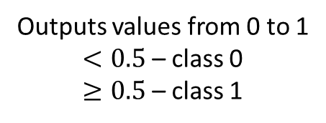


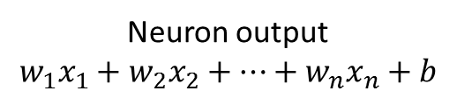

Logistic Regression Problem as a NN
Tumor Size
Neuron output
$$w_{1}x_{1}+w_{2}x_{2}+…+w_{n}x_{n}+b$$
Dense Layer
$x_{1}$
Age
$$w_{1}$$
Outputs values from 0 to 1
$<0.5$ – class 0
$≥0.5$ – class 1
$$x_{2}$$
$$w_{2}$$
$$w_{3}$$
Cross Entropy Loss
$$x_{3}$$
$$σ$$
$$x_{4}$$
$$w_{4}$$
$$b$$
Sigmoid function
$$σ\left(x\right)=\frac{1}{1+e^{−x}}$$
$$1$$

Slide 35





Least Squares Regression Problem as a NN
Dense Layer
No activation function (non-linearity), thus the value is unbounded
$x_{1}$
$$w_{1}$$
$$x_{2}$$
$$w_{2}$$
$$w_{3}$$
Mean Squared Error Loss
$$x_{3}$$
$$w_{4}$$
$$x_{4}$$
$$b$$
$$1$$

Slide 36
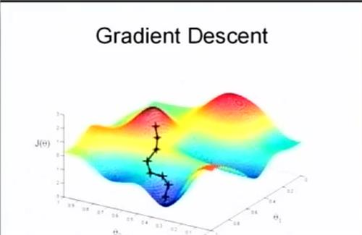
Optimization
Backpropagation using chain rule allows us to compute gradients for all parameters of deep networks
We use mini-batch gradient descent to optimize the network
Stochastic means we use small batches to update the model instead of the whole dataset

Slide 37
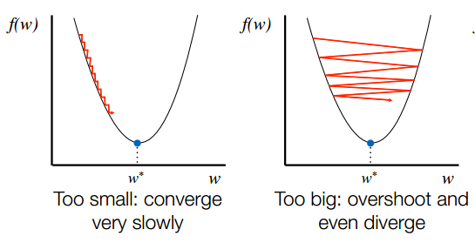
Learning Rate
Learning rate is a parameter you need to adjust wisely

Slide 38
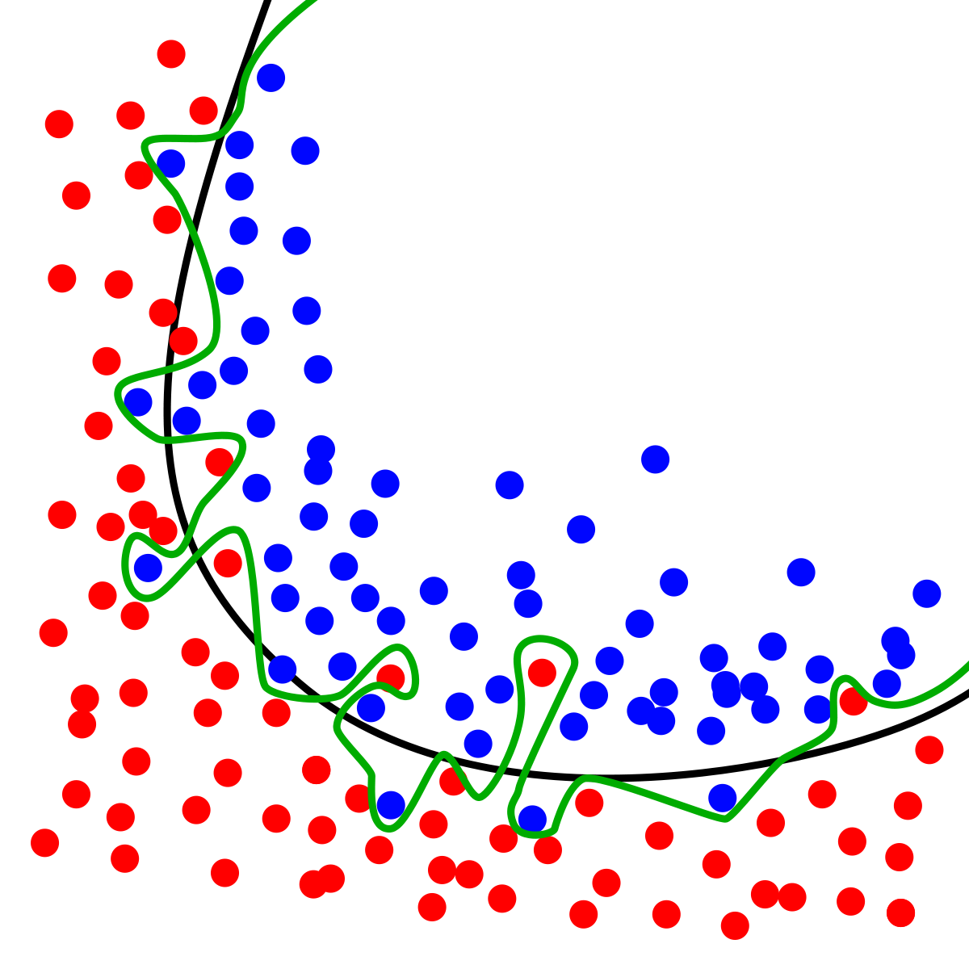
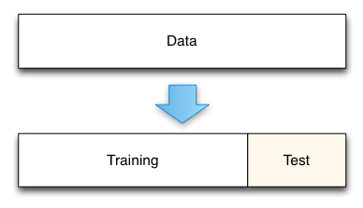
Training Neural Networks
Split all data to training and testing data
Train on training data
Evaluate performance on testing data
Make sure you don’t overfit the data
Overfitting Data
(green line)

Slide 39
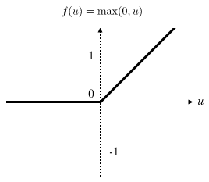



Activation Functions
A non-linearity function between layers of Neural Networks
The main reason why NNs are so powerful
Popular Activation Functions: Sigmoid, Tanh, ReLU (best in practice)
Dense Layer
$x_{1}$
$$W$$
$$x_{2}$$
$$f$$
Activation function
(Non-linearity)
(Neuron activation)
$$x_{3}$$
$$f$$
$$f$$
$$x_{4}$$
$$f$$
$$1$$
$$b$$
ReLU Function

Slide 40
Metrics
You should use metrics to track your performance
Popular metrics for classification:
Accuracy
Precision
Recall
PR AUC, ROC AUC

Slide 41
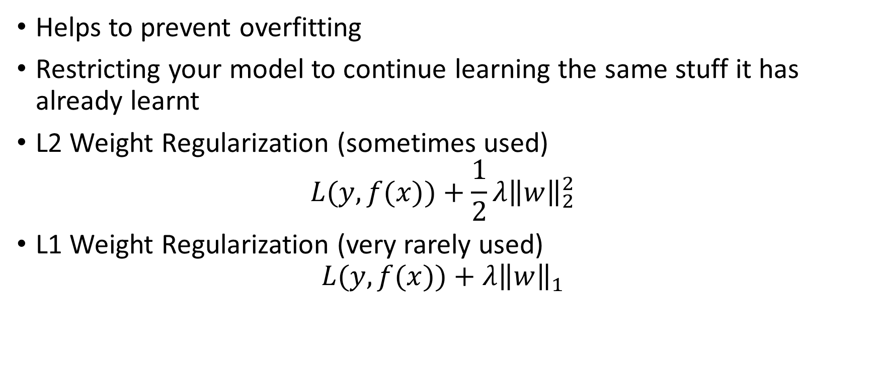
Regularization
Helps to prevent overfitting
Restricting your model to continue learning the same stuff it has already learnt
L2 Weight Regularization (sometimes used)
$$L(y,f(x))+\frac{1}{2}λ{\left\|w\right\|}_{2}^{2}$$
L1 Weight Regularization (very rarely used)
$$L(y,f(x))+λ{\left\|w\right\|}_{1}$$

Slide 42
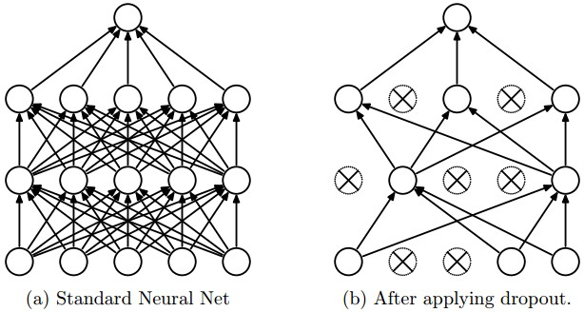
Dropout
Switching off random neurons of the layer with the given probability
Harder to train but harder to overfit as well

Slide 43
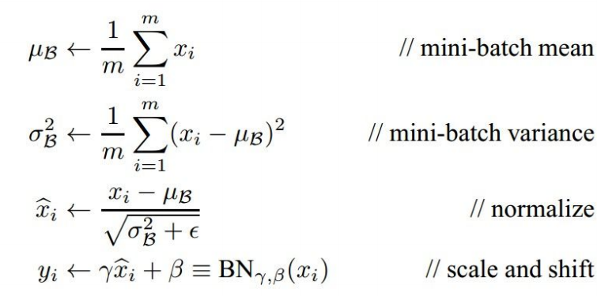

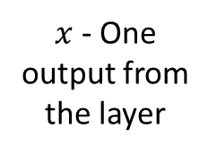
Batch Normalization
$m$ - Batch Size
$x$ - One output from the layer
Output of Batch Normalization
Trained parameters via backpropagation

Slide 44
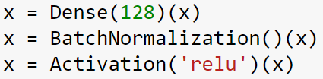
Batch Normalization
Extremely powerful technique
Decreases training time
A rule of thumb: Dense -> Batch Normalization -> Activation

Slide 45
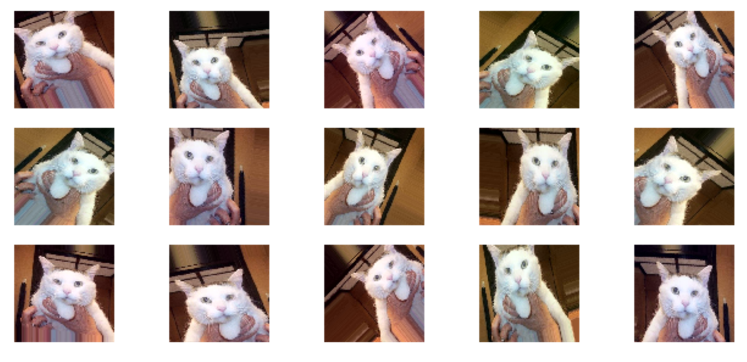
Data Augmentation
Artificially adding more data
Very specific to your task

Slide 46
Convolutional Neural Network
Learning small filters (kernels) to catch useful features
Using convolution operation to apply filter to every position on the feature map (or on the image)
Adding layers of convolutions – filters learn more complex features
Result of the convolution
Kernel
(i.e. filter)
has size 3x3
Initial Image

Slide 47
Max Pooling
Reducing spatial size (thus amount of computations)
Adding more non-linearity
Max Pooling window size is set to 2x2

Slide 48
Basic Structure of CNN
Flattening the feature map – making one shallow vector out of the ‘image’

Slide 49
Using Pretrained CNNs – Transfer Learning
There are plenty of high-performance pretrained NNs
Use pretrained weights and train from them instead of from scratch

Slide 50
This is it guys
To learn more we would recommend
Attend Deep Learning course by V. Lempitsky in Term 4
cs231n course from Stanford Univerity (http://cs231n.stanford.edu/)
Book – “Deep Learning” by Ian Goodfellow
Try to solve Kaggle Competitions

Slide 51
This is It For the Final Lecture

